Slide 1
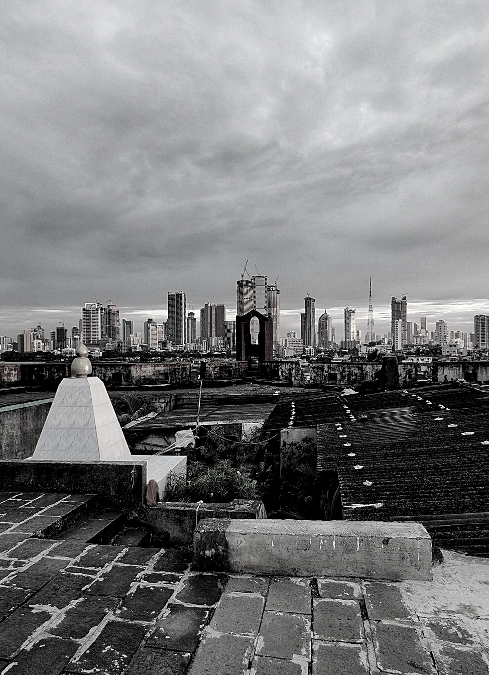
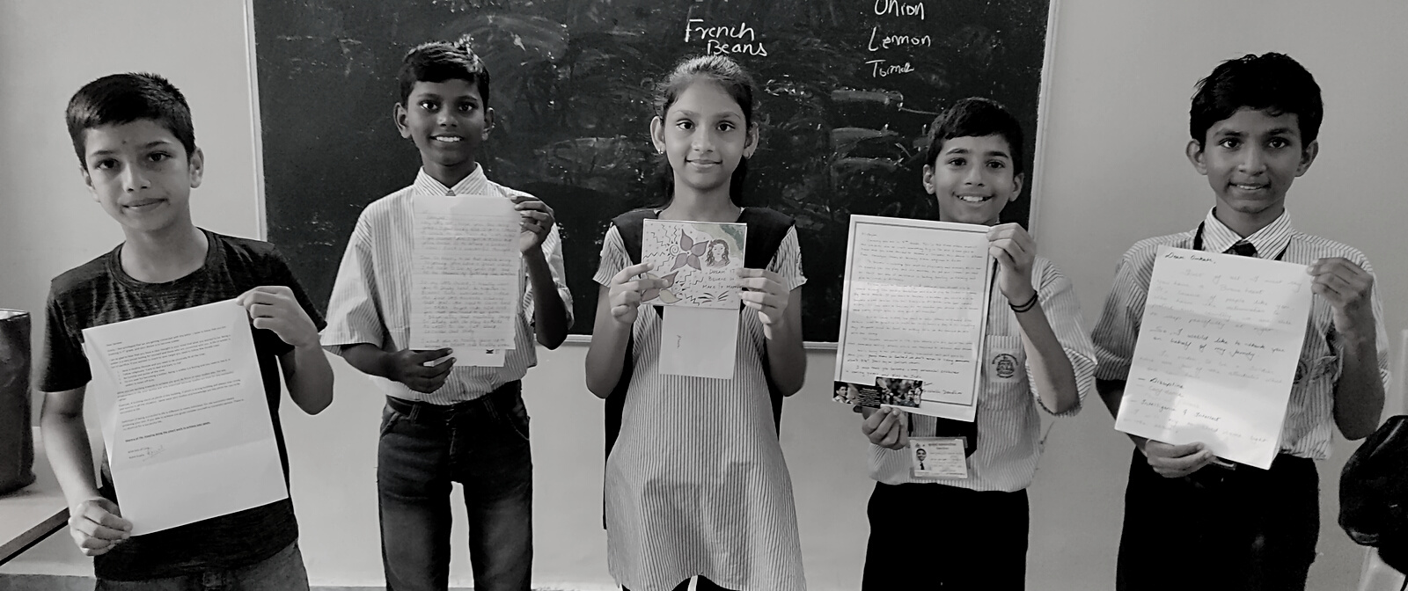
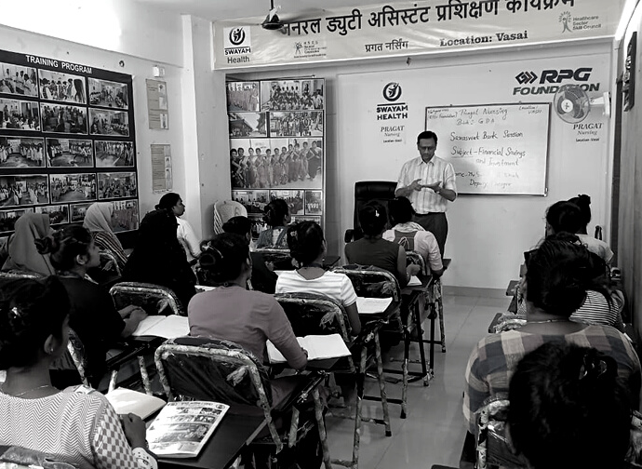
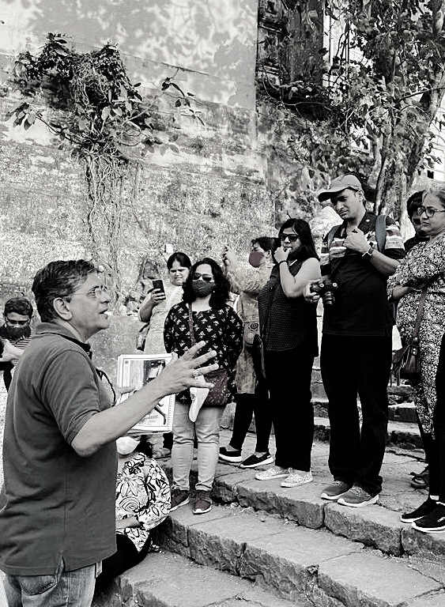
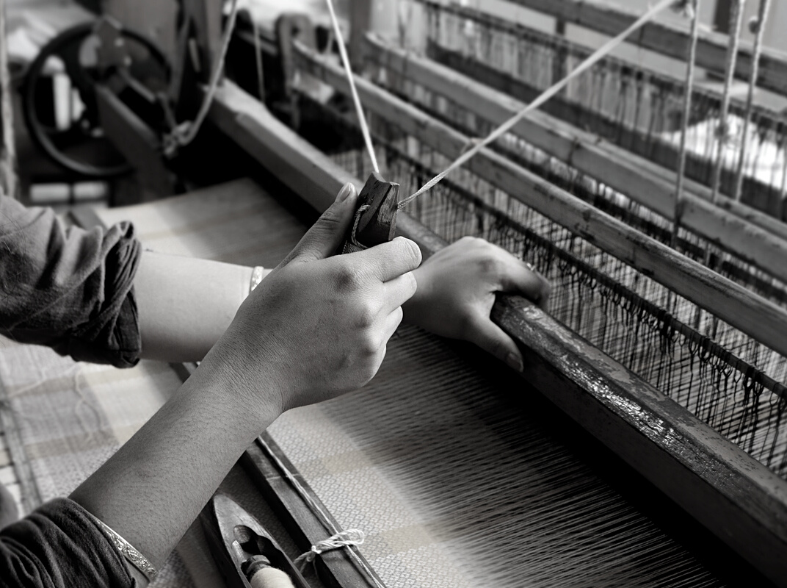
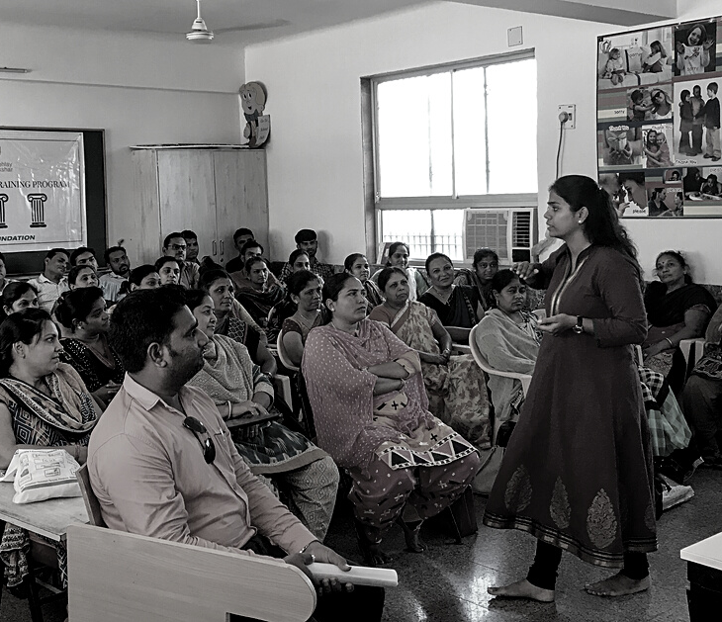
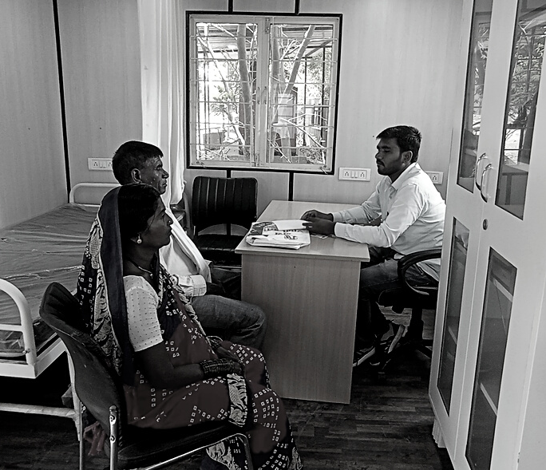
FY 23-24 UPDATES

Slide 2
PROPOSED ANNUAL ACTION PLAN FY 23-24
Program | Projects | Allocation for FY 23 – 24 | Utilization of Funds (Till Feb '24) | Planned Spends in Mar '24 | Estimated- FY 23-24
The Heritage Project | Biodiversity conservation around heritage sites in Mumbai | 24.00 | 18.06 | 5.94 | 24.00
Total | Total | 24.00 | 18.06 | 5.94 | 24.00

Slide 3
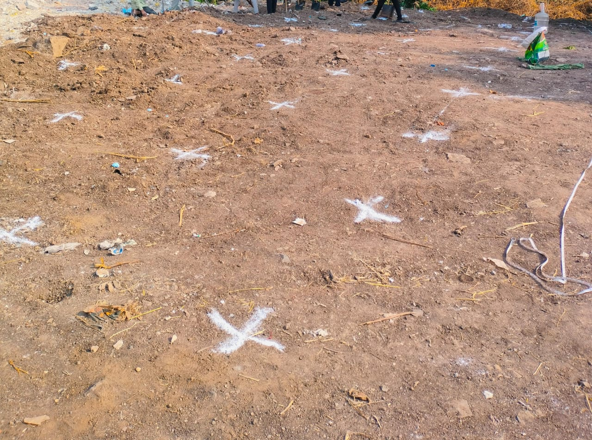
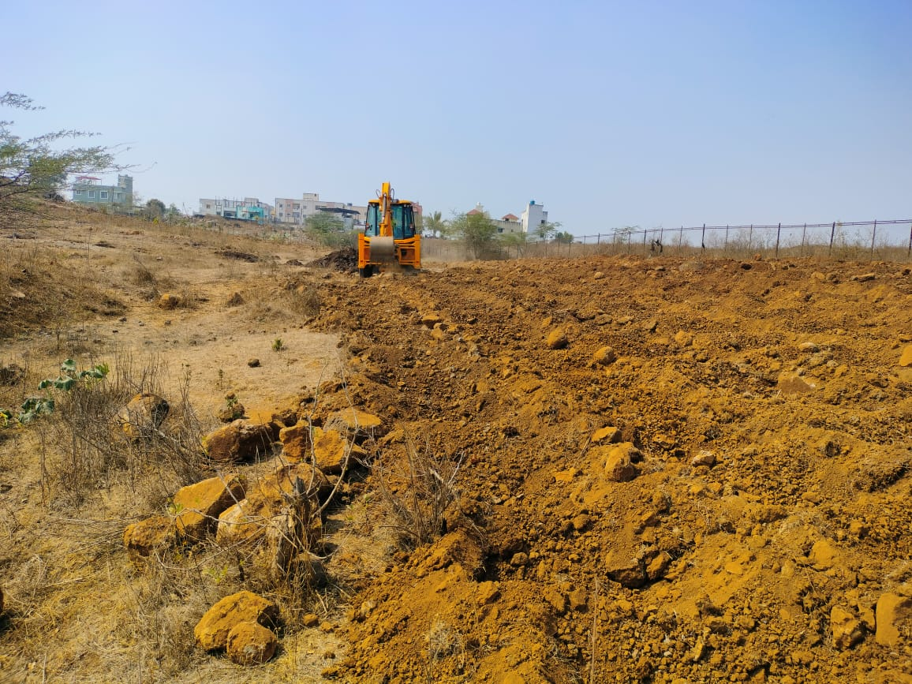
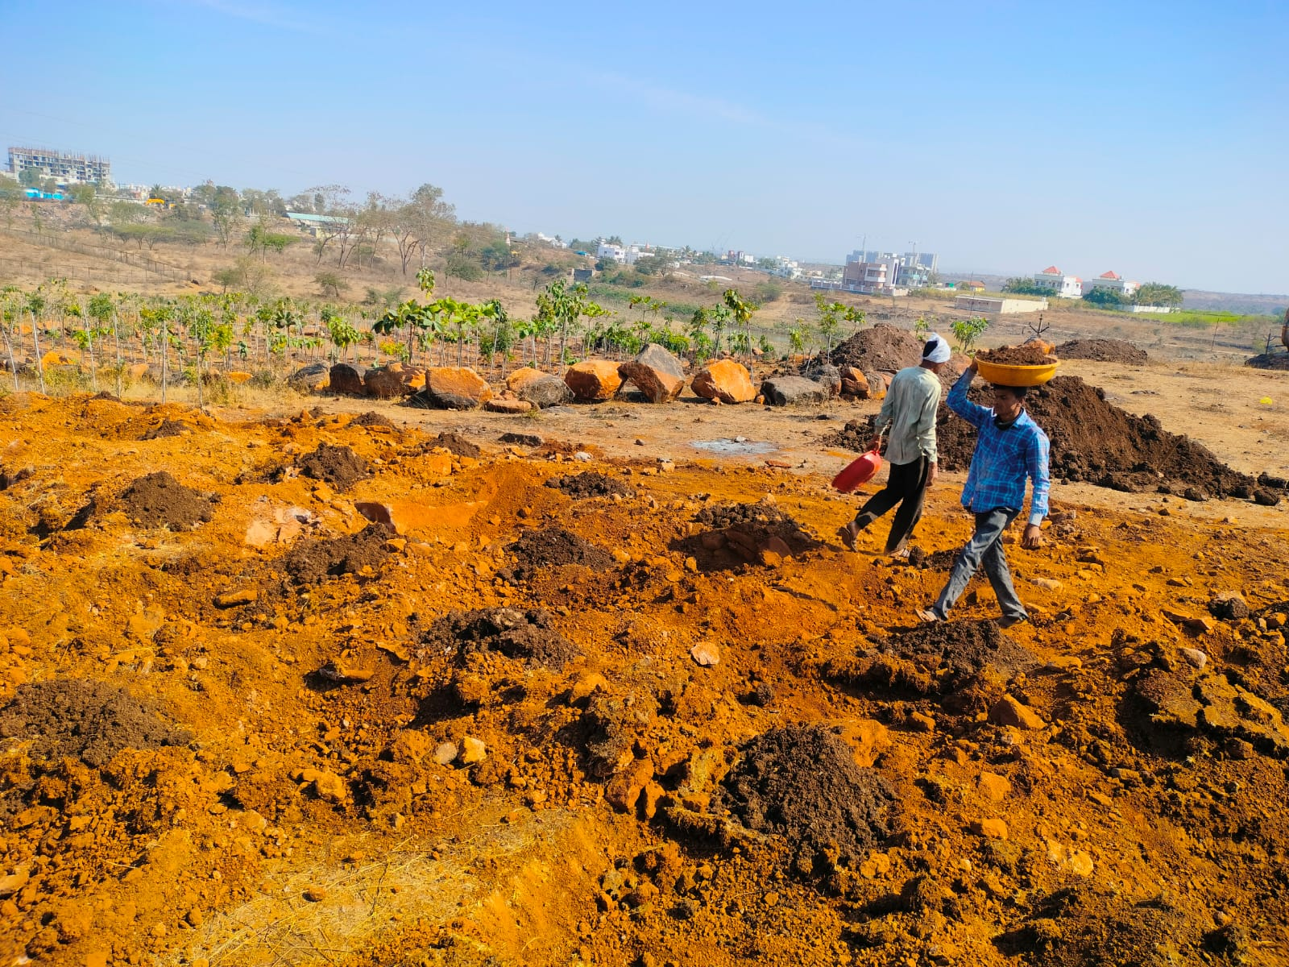
MIYAWAKI FOREST DEVELOPMENT – LOHGAON, PUNE
3 Steps of Land Preparation
Step 1: Marking on-ground according to the Miyawaki method of plantation
Step 2: Land preparation which includes land leveling and removing large stones and rocks through JCB.
Step 3: Land fertilization process includes digging pits and filling them with fertile black soil.

Slide 4
MIYAWAKI FOREST DEVELOPMENT – PLANT SELECTION
Barren land being transformed into a dense Miyawaki forest
Improves biodiversity, increases carbon capture, results in pollution filtration, soil binding due to plantation prevents floods, increases share and promotes cooling
Analysed suitability of land for selecting plants to ensure optimal growth and sustain plant health
Identified and planted 17 types,
Trees arranged in 4 layers – Grand cover, Tall trees, Medium and Small
Layers to be visible after 2 years of optimum growth, between 3-5 metres depending on the layers
3,306 native trees planted
17 varieties of trees planted including fruit and flower native trees
Organic fertilizers used for growth
Irrigation arranged - 10,000 liters weekly for plantation maintenance
Grand Cover | Taller Trees | Medium Size | Small Size
Saptaparni | Kadamba Ramphal Mohgani tree Bakul | Khaya Beltro Farm Ramphal Sour Tamarind Bitter Lemon Arjun Pimple Karanj | Tamhan Kanchan Okra

Slide 5
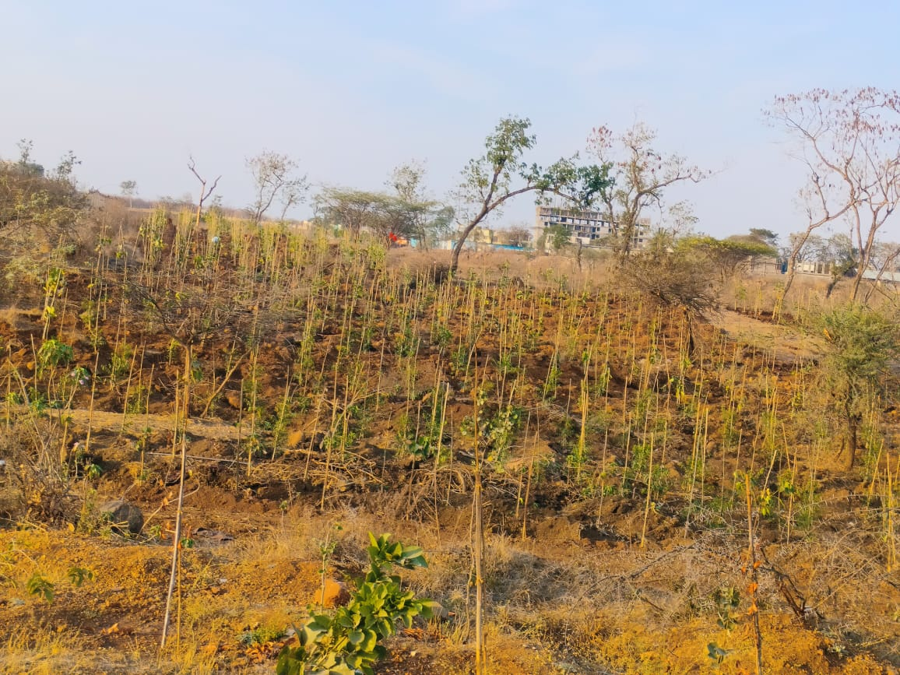
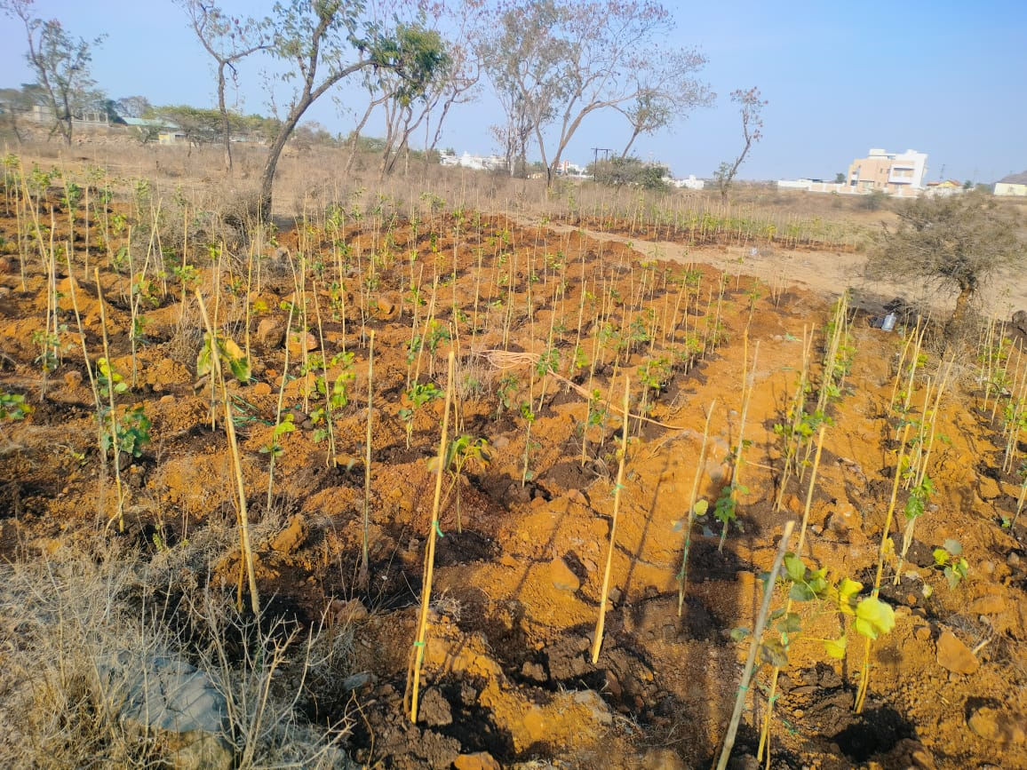
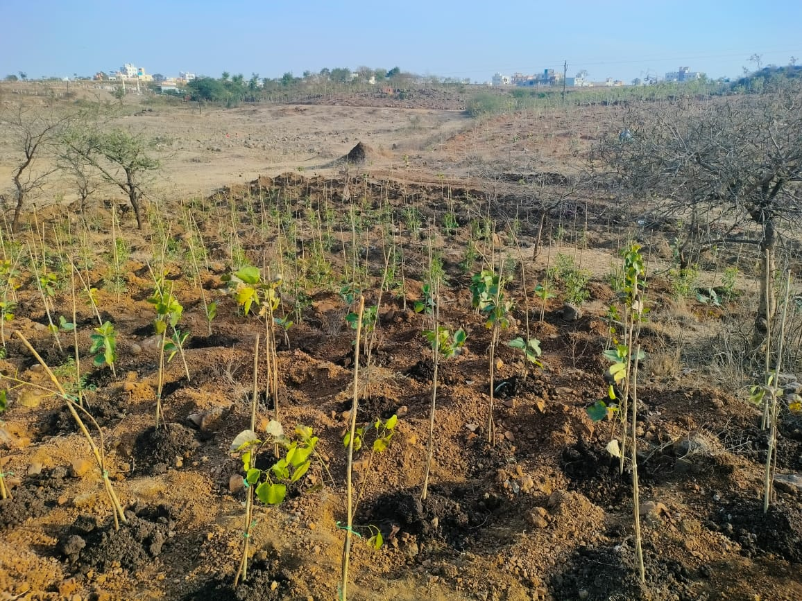
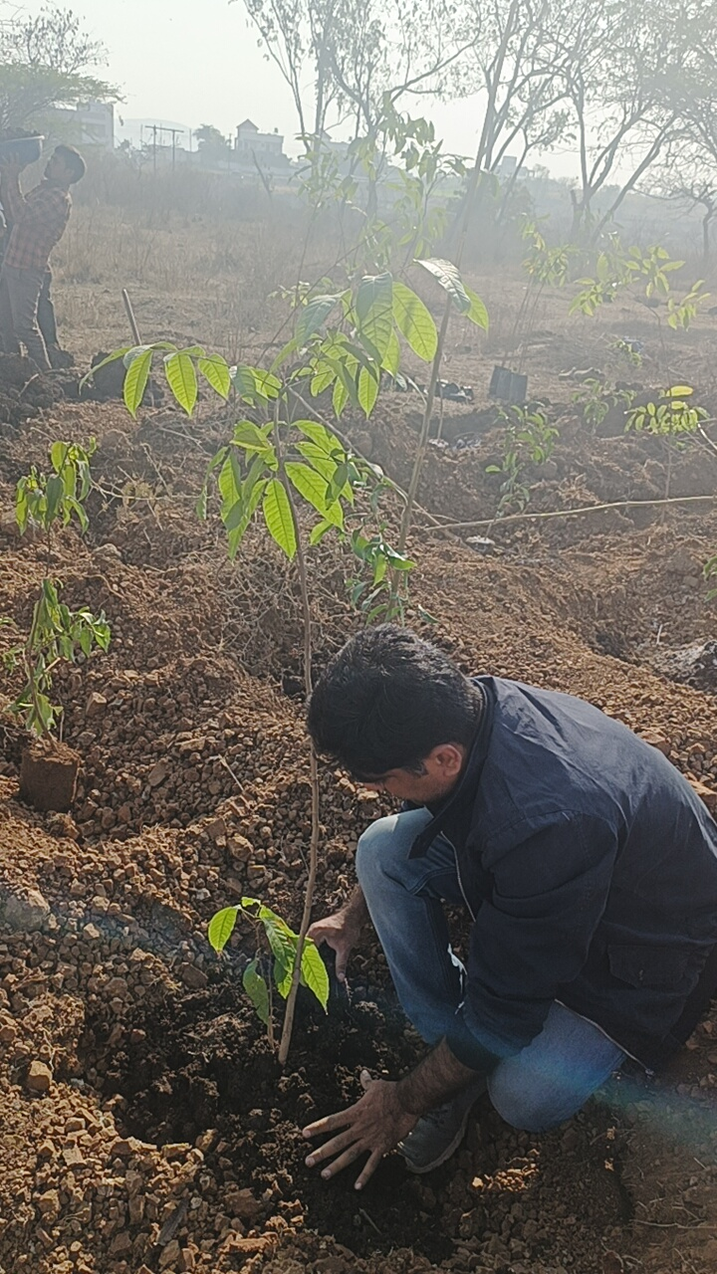
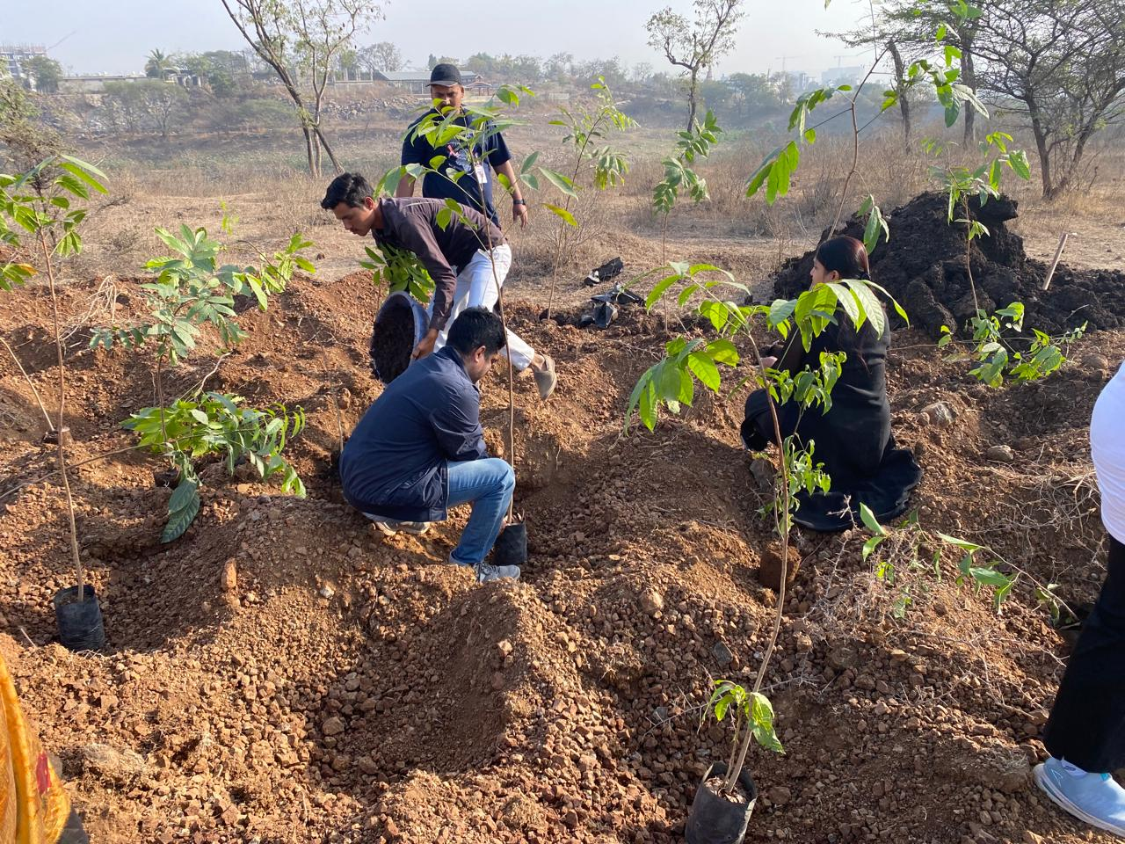
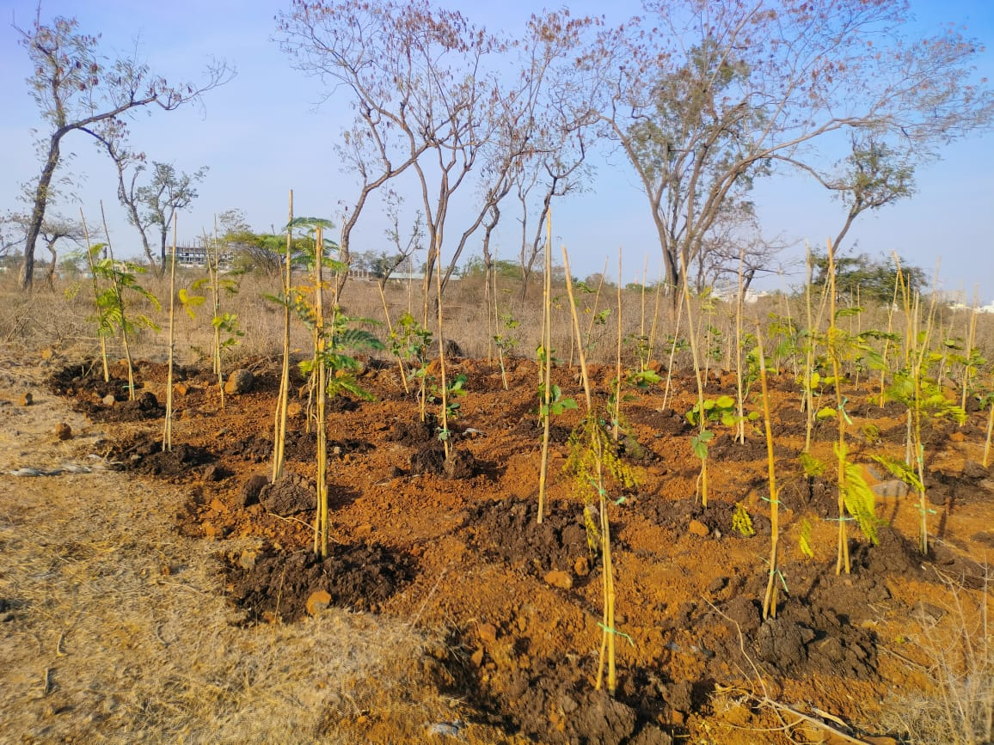
MIYAWAKI FOREST DEVELOPMENT – PLANTATION AND VOLUNTEER ENGAGEMENT

Slide 6
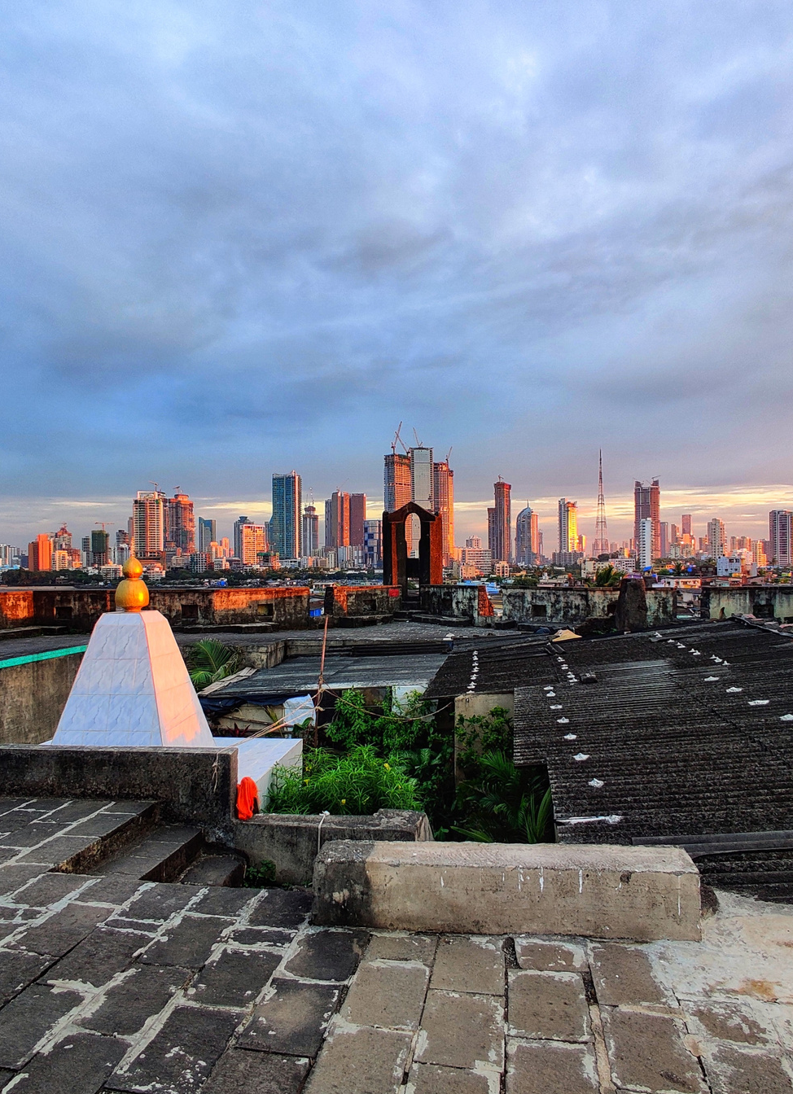
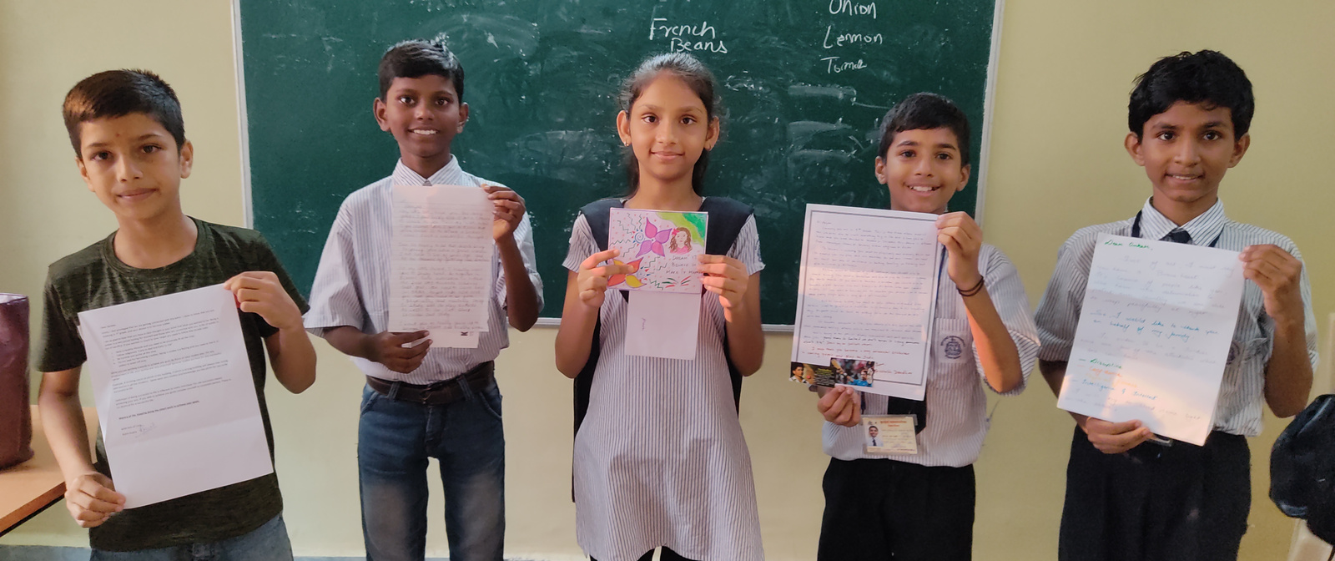
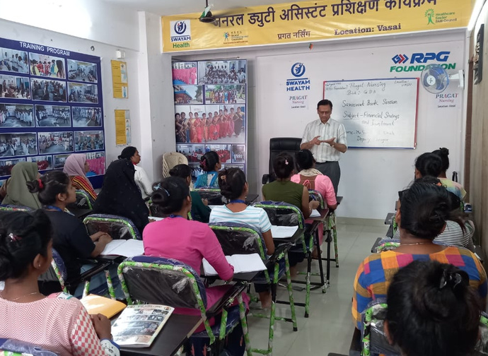
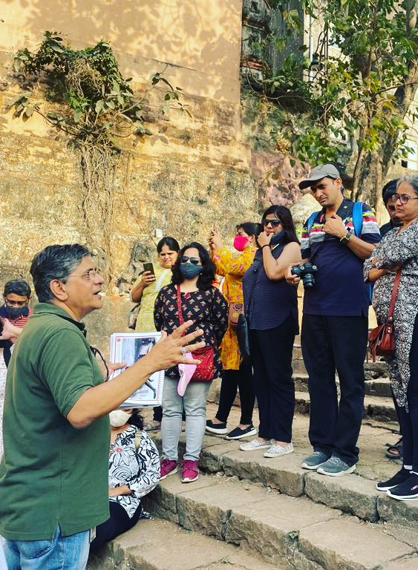
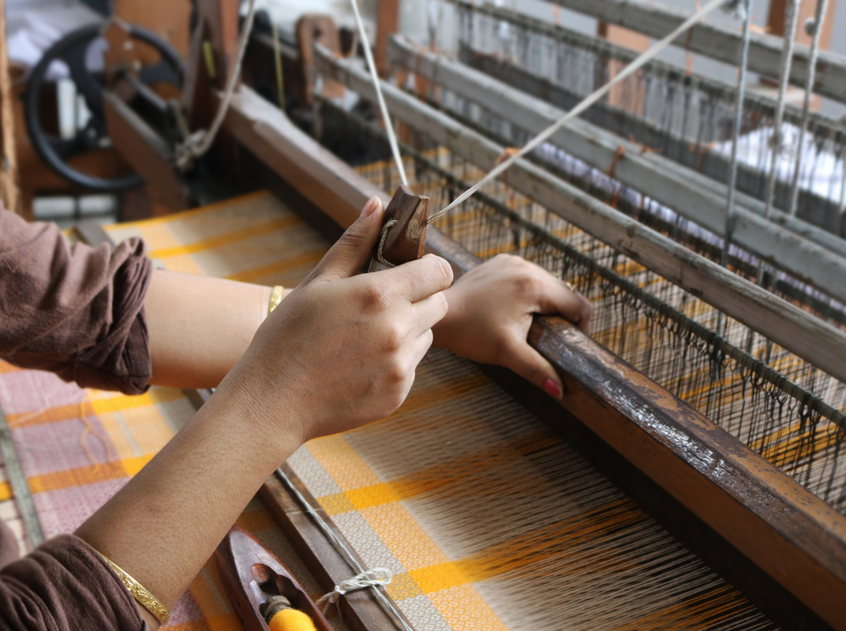
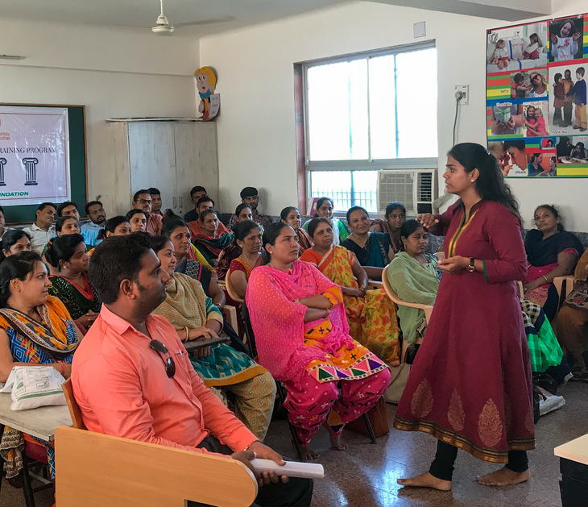
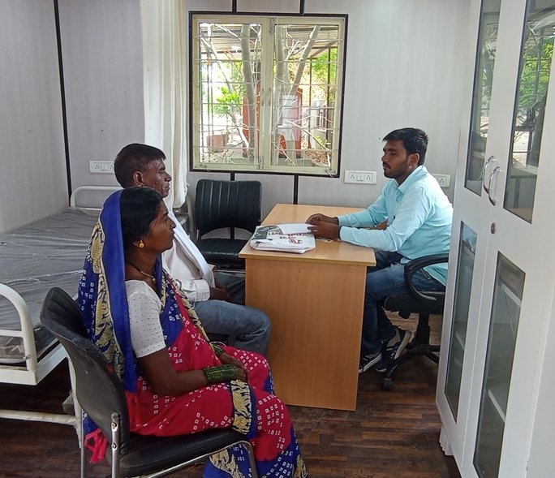
THANK YOU

